Slide 1
Leverett J-Function
By Leverett (1941)

Slide 2
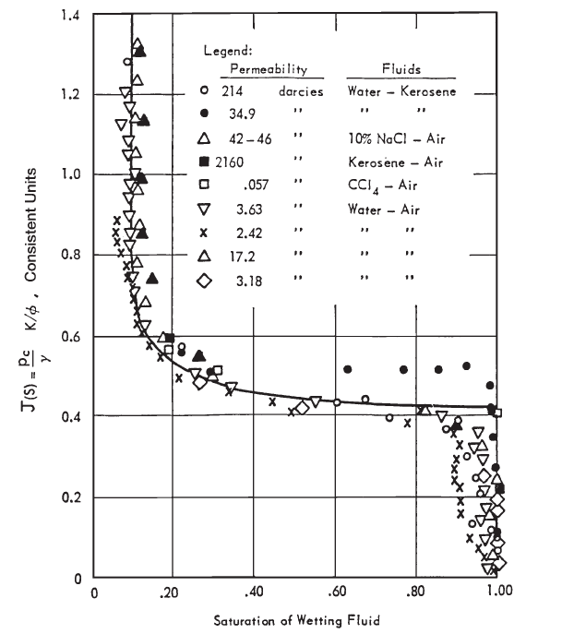

Slide 3
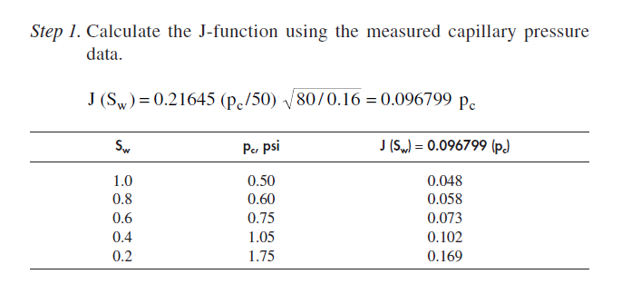

Slide 5
PERMEABILITY

Slide 6
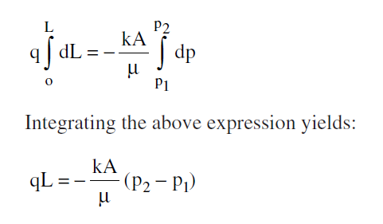

Slide 9
The Klinkenberg Effect

Slide 10
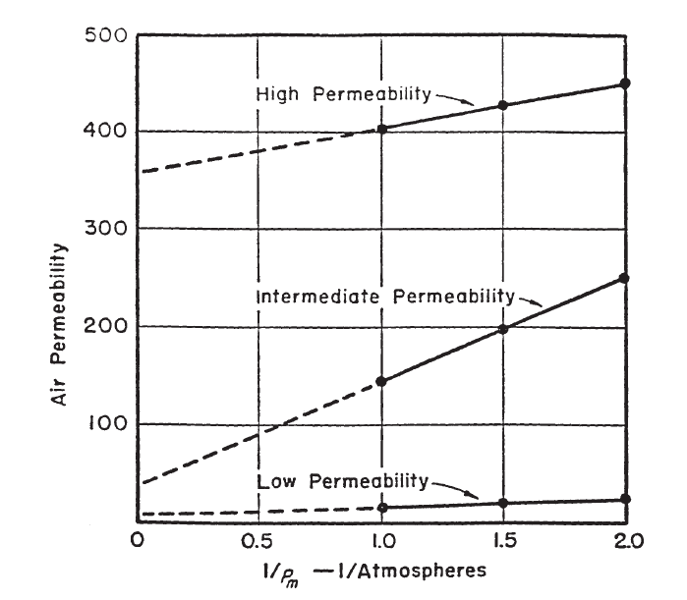

Slide 12
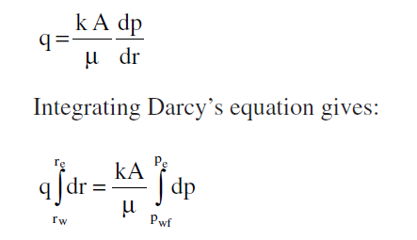
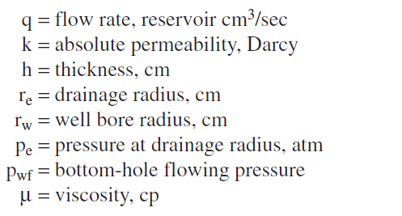

Slide 13
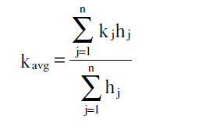
Averaging Absolute Permeabilities

Slide 14
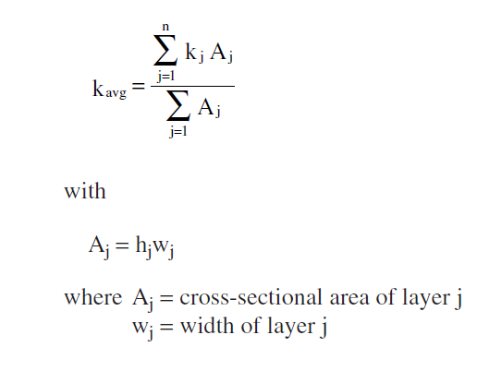

Slide 17
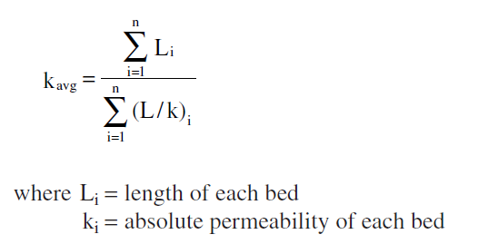
Harmonic-Average Permeability

Slide 18
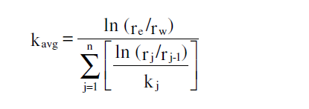

Slide 19
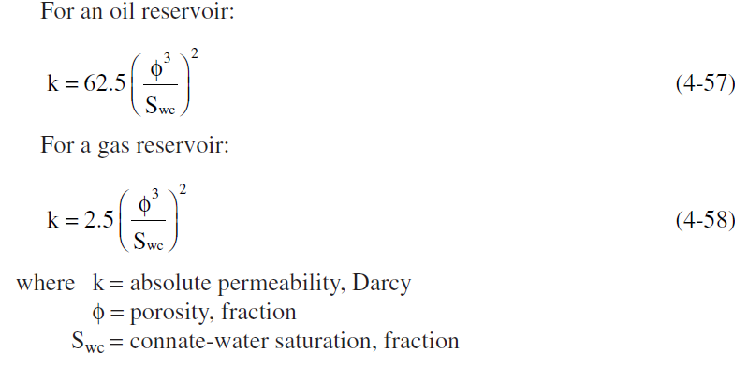
Absolute Permeability Correlations
The Timur Equation
The Morris-Biggs Equation

Slide 20
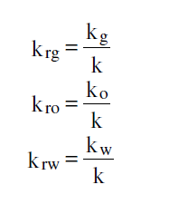
Effective and relative permeability

